Slide 1
Introduction to Restore! Life Skills Program
Rev. Shelley Chandra Jyoti Swan
Saturday, April 2nd 2016 ⋅ 9am to 3pm
© Restore! Program, 2016

Slide 2
Agenda Overview
Introduction to Restore! Life Skills Program
Introduction to the Dialog Process
Break for Lunch at 11:30
Stretch and Balance under the oak
How it works!
Learn. Lead. Teach.
Personal Testimonies
Q & A

Slide 3
When we realize that what we are looking for is actually within us, we can focus on how to express what we are, rather than on trying to find something that we have never lost or trying to be someone we are not.
—Yogacharya Ellen Grace O’Brian

Slide 4
Restore! Life Skills Program
a dynamic dialog process
meditation techniques for optimal well-being
restorative breathing exercises for inner peace
relaxation techniques for reduced stress
concentration practices for enhanced focus and productivity
personal tools for long term success
tools and techniques for teaching others

Slide 5
The Dialog Process
History and Intention
Question-Based Methodology
Connecting
Discovering
Taking Action
Deep Listening and Allowing

Slide 6
Guidelines for Conversations…
Experience each other as equally human
Give each person time to talk
Deep, appreciative listening & heart felt sharing
Let go of the need to agree, allow each person their own truth with grace and respect

Slide 7
Segment One
Who am I?
What is my connection to this place and the services that are offered here?
Why is it important to me?
What brings me to this workshop today?

Slide 8
Segment Two
What is the source of my most deeply held values?
What do I see as the greatest need of the time we are living in?
What in my life experience has inspired me to do the work that I do?
What is the greatest challenge I face with the service I offer?

Slide 9
Segment Three
What do I think we are called to do with the particular work that we do in the community?
In my highest vision, what potential do I see for the service we provide?
What makes me believe that with sufficient energy and support that potential could be realized?

Slide 10
Introduction to Restore! Life Skills Program
Rev. Shelley Chandra Jyoti Swan
Saturday, April 2nd 2016 ⋅ 9am to 3pm
© Restore! Program, 2016

Slide 11
How it works!
Restore! for Service Providers
Restore! for Kids: My Time and Our Time Program
Restore! Afterschool Program
Restore! for Parents – Spanish and English
Restore! Reclaiming the Light Within
Restore! for University Students

Slide 12
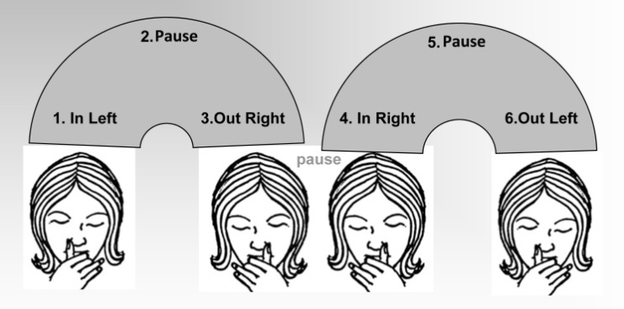
Learn. Lead. Teach.
Alternate Nostril Breath
Begin sitting in a comfortable position. Keep the spine straight. Relax the body—shoulders, face, throat.
Close the eyes and begin to focus on the breath.
Breathe in through both nostrils gently & fully
Exhale fully and completely
SIX BASIC STEPS
Close the right nostril with your right thumb and inhale through the left nostril
(pause)
Close the left nostril with your ring finger and little finger, and at the same time remove your thumb from the right nostril, and exhale through this nostril.
Inhale through the right nostril
(pause)
Close the right nostril with your right thumb and exhale through the left nostril.
Start by doing three rounds a day, adding one round per week until you are doing six rounds per day.

Slide 13
Learn. Lead. Teach.
Ocean Breath
Begin sitting in a comfortable position. Relax the body—shoulders, face, throat. Close the eyes and begin to focus on the breath. Turn your attention and awareness within. Follow these four steps:
FOUR STEPS
Inhale through your nose, then exhale slowly through a wide-open mouth.
Direct the out-going breath slowly across the back of your throat with a drawn-out “HA” sound.
Repeat several times. Then close your mouth for the exhalation as well as the inhalation.
Now, as you both inhale and exhale through your nose, direct the breath again slowly across the back of your throat. Ideally, this will create, and you should hear, a soft hissing sound.
Try practicing it first for just one or two minutes and then enter into meditation. This technique can also be used as a stand-along practice to de-stress in just a few minutes.

Slide 14
Learn. Lead. Teach.
Cooling Breath
Begin sitting in a comfortable position. Relax the body—mouth, face, throat, and shoulders.
Hands gently resting in your lap. Begin to focus on the breath.
Follow these simple steps:
FOUR STEPS
If you can, curl both sides of the tongue inwardly, rolling into a tube shape. *note alternate version
Slowly breathe in through the tube like shape
When your inhale is complete, relax your tongue—allowing it to unroll to it’s natural from as you exhale slowly through your nose.
Repeat 3-4 rounds in the beginning and build up to 10 per sitting.

Slide 15
We are each unique expressions of the one Reality, dwelling in the family of all beings. Our discipline in life is to cooperate with the way the infinite Reality wants to express through us. That is how we take up our rightful place.
—Yogacharya Ellen Grace O’Brian

Slide 16
Thank you!

